Slide 1
Chapter 6: Evidence for change

Slide 2
Evidence for evolution
Evolution is the scientific explanation for the mechanisms that drive species to change over time.
A significant source of evidence for evolution comes from the fossil record.
The modern evolutionary synthesis combines evidence from the fossil record with our relatively modern knowledge of how genes are inherited and how changes to genes arise to give a complete picture of the mechanisms of evolution.

Slide 3
Understanding the time scale
Geologic time
Evolution has occurred over very vast stretches of time.
These are called periods, eras, epochs and eons.
Geologic time can be expressed in millions of years ago (mya).

Slide 4
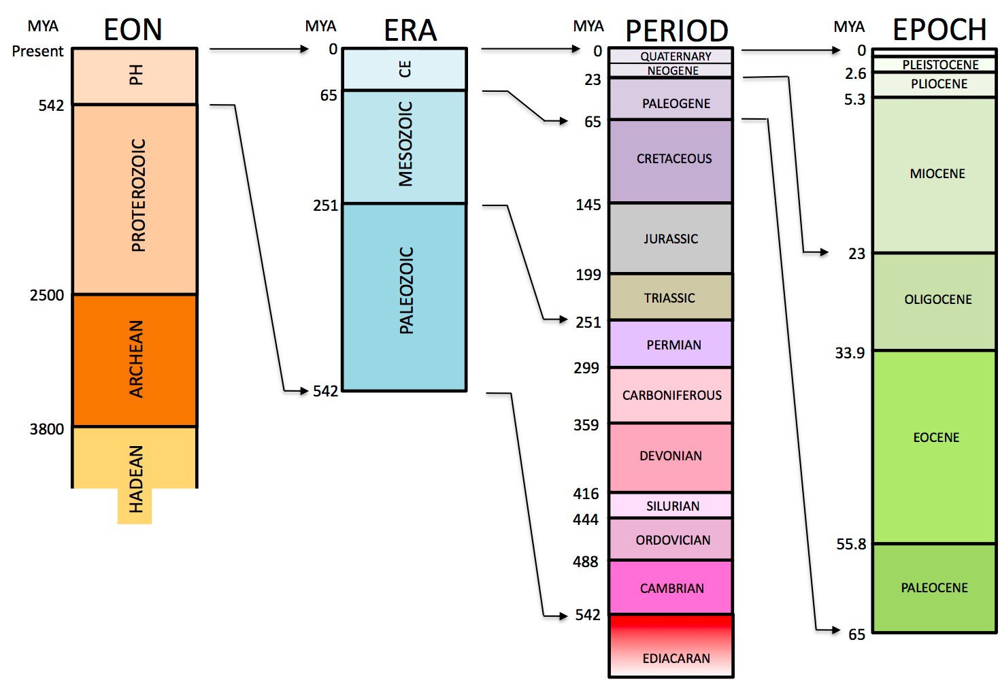
Geologic time

Slide 5
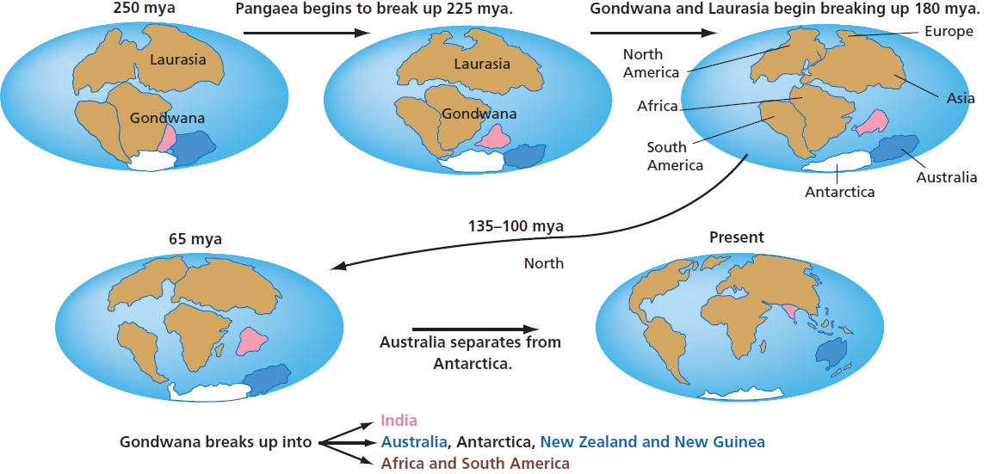
Continental drift
Geologic time
Over time, the tectonic plates have moved significantly in a process called continental drift. The fossil record can attest to this and the current biogeography is explained by continental drift.
Figure 6.2

Slide 6
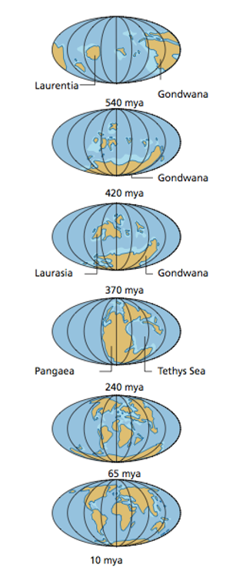
Continental drift
Geologic time
Over geological time, several different continents have existed, including the southern content Gondwana and
the supercontinent Pangaea.

Slide 7
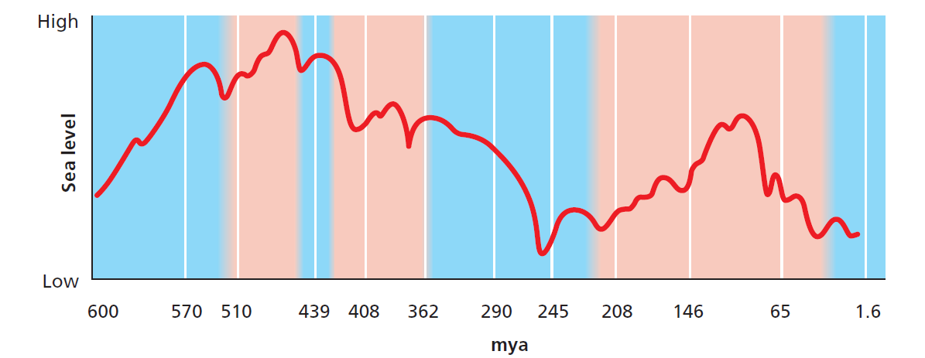
Climate variations
Geologic time
Large climate oscillations have occurred on Earth over its history. These oscillations have occurred in Earth’s temperature, humidity and sea level.
Figure 6.4

Slide 8
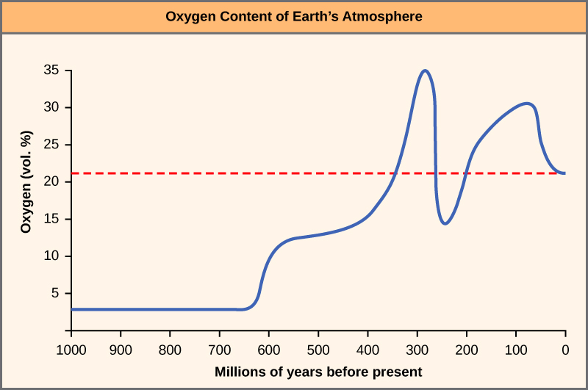
Oxygen levels
Geologic time
The oxygen level of Earth’s atmosphere rose sharply around 300 mya.
The gradual increase in the atmospheric oxygen level corresponds with an increase in organisms’ body size in the fossil record.
This corresponds with the Carboniferous period and the rise of photosynthetic plants
http://cnx.org/content/m44660/latest/?collection=col11539/latest

Slide 9
Evidence for evolution
Five lines of evidence support evolution
Paleontology - the study of prehistoric life, particularly the fossil record
Biogeography - the study of the distribution of species over time
Developmental biology - the study of the process by which organs develop
Morphology - the study of the form and structure of organisms
Genetics - the study of genes, heredity and variation in living organisms
Further evidence is provided by:
Comparative genomics – the comparison of genomic features of organisms
Comparative biochemistry – the comparison of proteins of organisms
Bioinformatics – analysis of large data sets (such as the genomic sequences of different organisms)

Slide 10
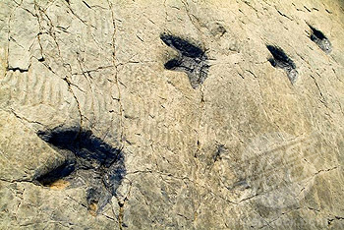
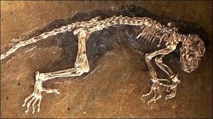
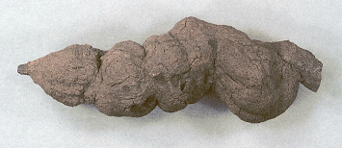
Evidence for evolution
The fossil record
Fossils are the preserved remains of organisms and their traces.
They are commonly hard parts such as teeth, bones and shells but also include impressions left after soft tissue has decayed, or footprints, burrows or preserved faeces (coprolites).
https://www.dmr.nd.gov/ndfossil/poster/hellcreek/Hellcreekp2.asp

Slide 11
Fossilisation
Evidence for evolution
Fossilisation is a rare process and very few organisms are preserved in the fossil record.
Fossilisation requires the absence of oxygen.
In some situations, the hard parts of organisms are replaced with minerals. This is mineralisation and makes fossiliation more likely.
Organisms can be covered with sediment such as silt or sand. This can protect the remains from scavengers and slow the decay long enough for fossilisation to occur.

Slide 12
Fossilisation
Evidence for evolution
Fossils are not usually found in volcanic rock, as molten lava solidifies at 1000°C.
Fossils are also not usually found in metamorphic rock as the pressure and heat of metamorphism is likely to destroy fossils.
Fossils can be formed as a result of freezing and subsequent dehydration, by soft material such as ash falling on impressions, or from impressions made in sandstone and mudstone.

Slide 13
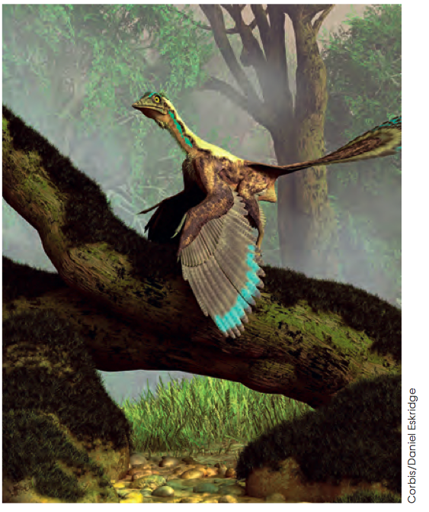
Transitional forms
Evidence for evolution
Transitional forms in the fossil record show important intermediate states between an organism’s ancestral form and that of its descendants.
A famous transitional form is Archaeopteryx, the dinosaur/bird transitional form.
Because transitional forms usually did not remain in their state for long periods, the probability of a specimen being captured in the fossil record is low.

Slide 14
Pace of evolution
Evidence for evolution
Gradualism is the concept that assumes that evolution of species occurs at a slow, steady pace.
The theory of punctuated equilibrium, on the other hand, states that evolution occurs in bursts and between the bursts are periods of relative stasis.
Consider how an imperfect fossil record, in which specimens can rarely be found, would influence scientific theory about the pace of evolution.

Slide 15
Dating of fossils
Evidence for evolution
Comparative dating of fossils can give an idea of how old a rock (perhaps containing a fossil) is in relation to surrounding rocks, since we know that sedimentary rock is formed by gradual deposition of sediments.
Lower rock is assumed to be older than rock that is higher.
The rock may have tilted or even rotated, so this method requires careful observation.
Absolute dating involves the use of techniques that can assign a numerical age to a fossil or rock. Techniques include:
Radiometric dating - takes advantage of known rates of atomic decay
Electron spin resonance - electrons trapped in a material gain magnetic force as a result of exposure to environmental radiation over time.
Luminescence techniques - measure light emitted from a material

Slide 16
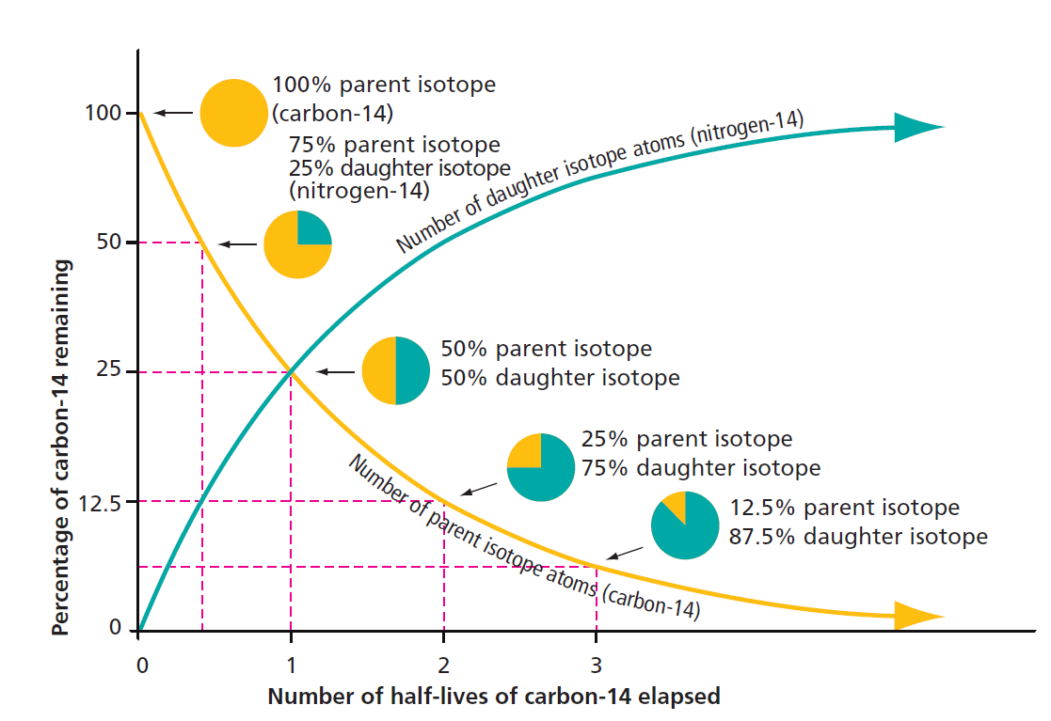
Dating of fossils
Evidence for evolution
Isotopes break down at a steady rate over time. For example, carbon-14 decays to nitrogen-14 and has a half-life of 5.73x10³±40 years.
The relative proportions of carbon-14 and nitrogen-14 can give an indication of the degree of decay that has occur and thus the age of the material.
Figure 6.7

Slide 17
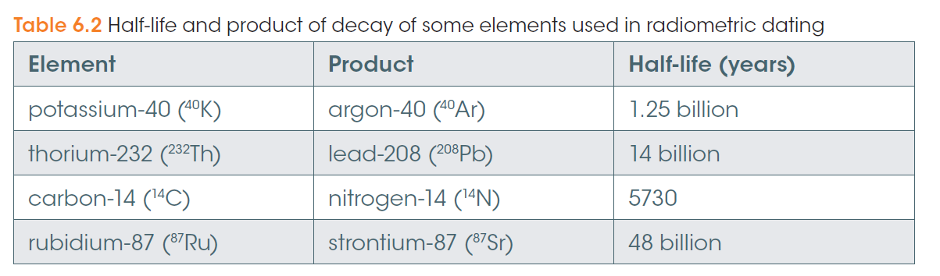
Dating of fossils
Evidence for evolution
Error margins for radiometric dating grow in magnitude the older an object is.
Most of the organic (carbon-containing) material is replaced or altered over time and the process of fossilisation occurs over a larger time period than then maximum accuracy for carbon dating (12 000 years).
For these reasons, other isotopes are used for older samples.

Slide 18
History of evolutionary theory
Patterns of evolution
1735
Carl Linnaeus publishes a system of classification for living things and proposes that interbreeding between species forms new species
1798
Thomas Malthus argues that human populations grow faster than food supplies, limiting population sizes, an idea that Darwin later considers
1809
Jean-Baptiste Lamarck proposes that organisms can acquire useful traits in their lifetimes and pass them onto their offspring
1835
Charles Darwin travels on HMS Beagle to the Galapagos Islands where he observes that the demands of the environment lead to changes in species
1859
Darwin publishes ‘The Origin of Species’ which describes how species evolve through the process of natural selection
1861
The first archaeopteryx specimen is discovered, providing a link between dinosaurs and birds
1865
Gregor Mendel describes his experiments with pea plants, making the first advance into the basis of inheritance and the modern evolutionary theory
Adapted from: http://www.boston.com/news/specials/evolution/evolution_timeline/

Slide 19
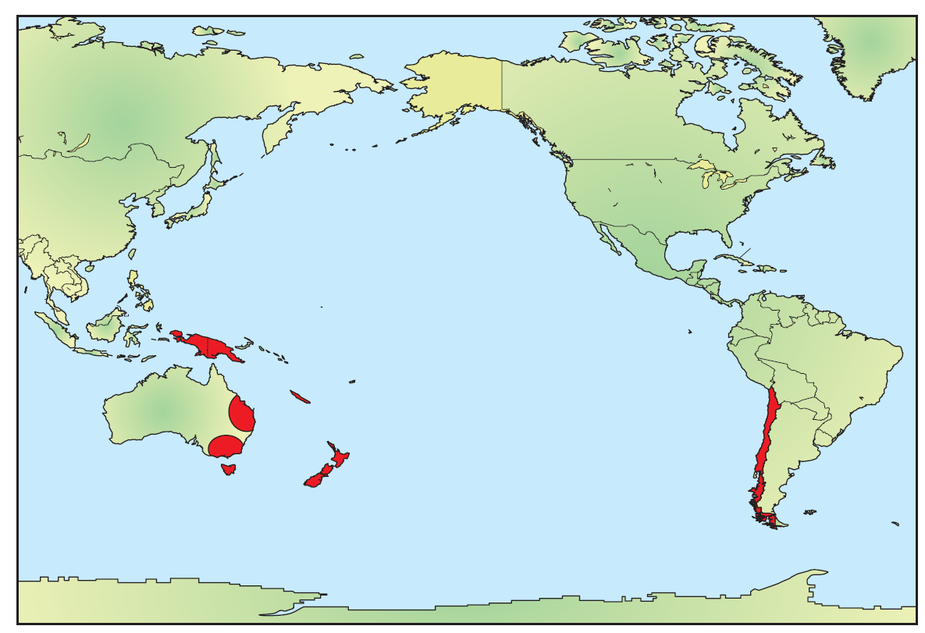
Biogeography
Patterns of evolution
The geographical distribution of species provides evidence that now isolated locations were once close.
The differences between species in different locations can give an indication of how much time has passed since they were co-located.
Figure 6.8
In red – locations of Southern beech trees (living specimens and fossils) which first lived in the late Cretaceous period.

Slide 20
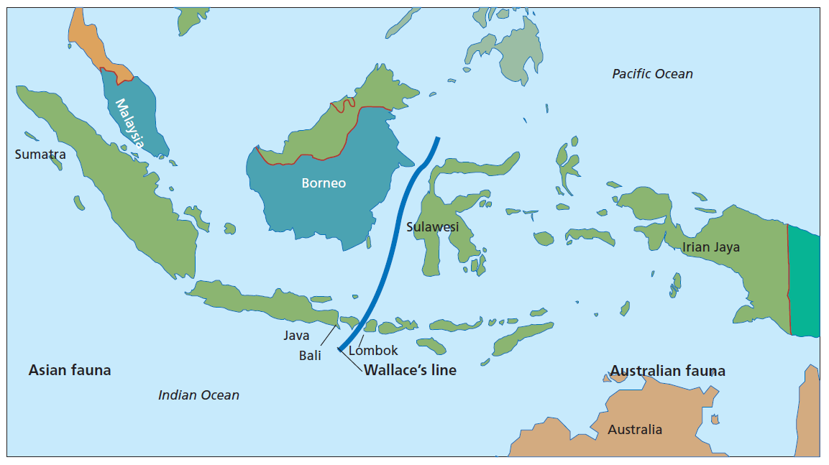
Wallace’s line
Patterns of evolution
Figure 6.9
Wallace’s line marks the boundary between the location of Asian fauna and Australian fauna.

Slide 21
Divergent evolution
Patterns of evolution
Divergence occurs as groups of organisms change over time, accumulating enough changes that they become different species.
Formation of a new species is speciation.
This usually happens when groups of a single species disperse to different environments which then become isolated, preventing individuals from moving between the groups.

Slide 22
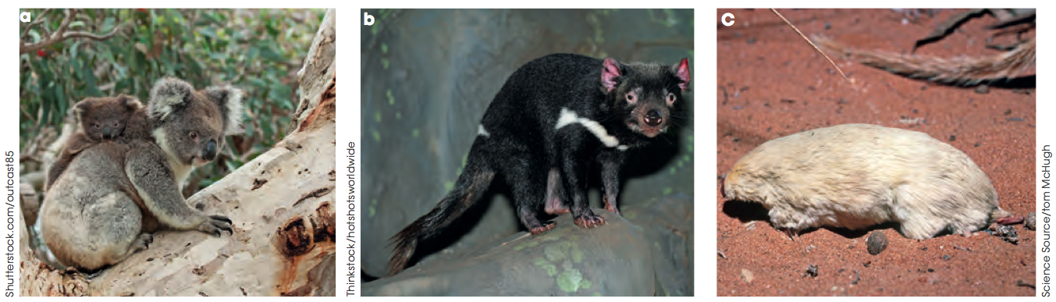
Divergent evolution
Patterns of evolution
A group of organisms with a recent common ancestor may evolve different adaptations in response to a range of environmental pressures.
Examples include koalas, Tasmanian devils and marsupial moles, which shared a common ancestor in the Eocene epoch.
Figure 6.10

Slide 23
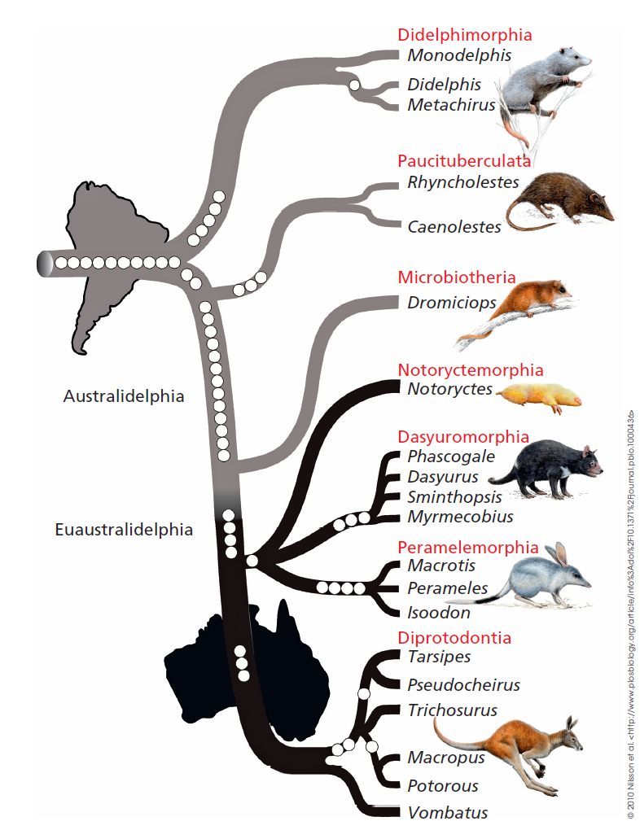
Adaptive radiation
Patterns of evolution
Adaptive radiation occurs when new environments or environmental niches become available to species, such as following a mass extinction.
An example of adaptive radiation occurred when marsupials reached Australia.
They diversified to fill many different environmental niches.
Figure 6.12

Slide 24
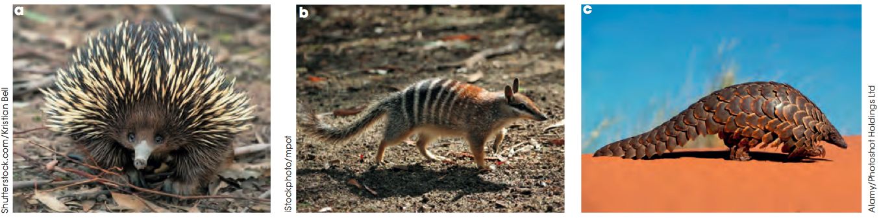
Convergent evolution
Patterns of evolution
When different species evolve similar adaptations in response to similar environmental demands or opportunities, this is convergent evolution.
An example of convergent evolution is the adaptation of ant-eating structures in ant-eating species.
These are termed analogous structures; structures that have independently evolved for the same function.
Figure 6.13

Slide 25
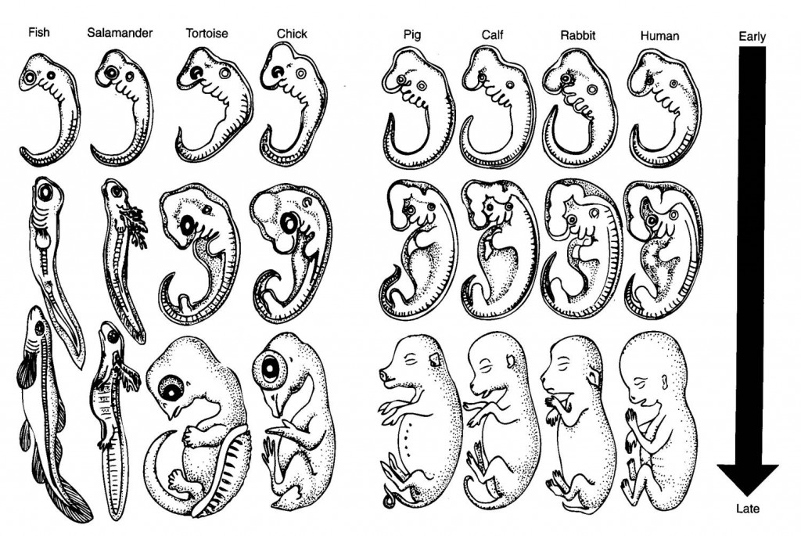
Comparative anatomy
Evidence for evolution
Embryology is the comparative study of vertebrate embryos, which share similarities across a large range of species even with relatively distant common ancestors.

Slide 26
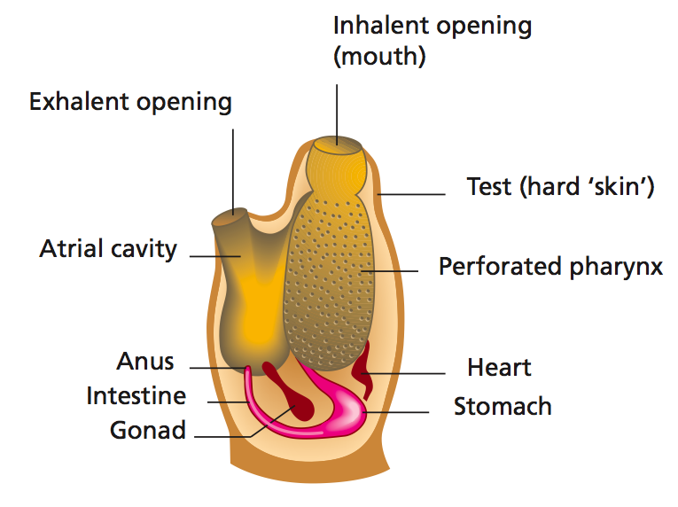
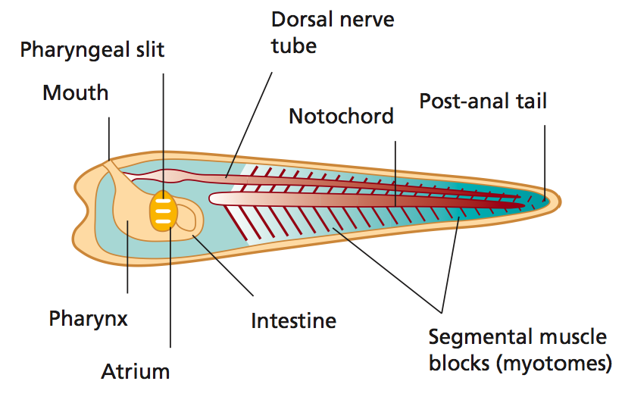
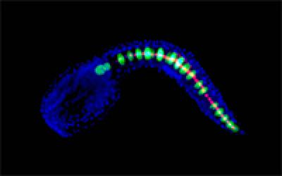
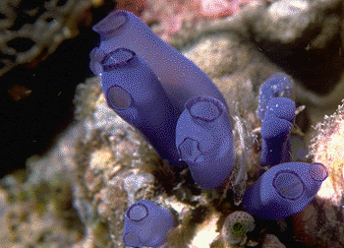
Comparative anatomy
Evidence for evolution
Even sea squirt embryos have the required features:
Figure 6.15
Janice H. Imai and Anna Di Gregorio

Slide 27
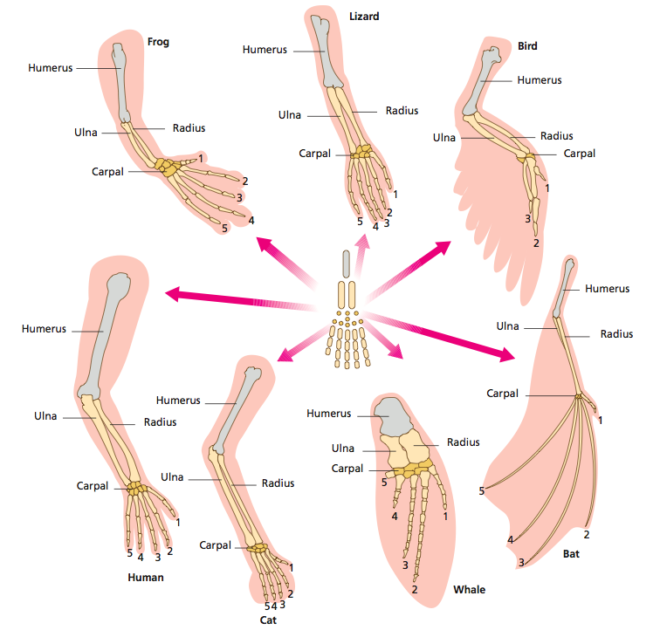
Homologous structures
Evidence for evolution
Homologous structures are features that were present in common ancestors and have evolved to perform different functions in descendent species.
Figure 6.17

Slide 28
Vestigial structures
Evidence for evolution
Vestigial structures are homologous structures that no longer have a function in the descendent species.
They are usually rudimentary or atrophied. An example is the human appendix, the remains of the caecum that is found in the digestive tract of herbivorous primates.

Slide 29
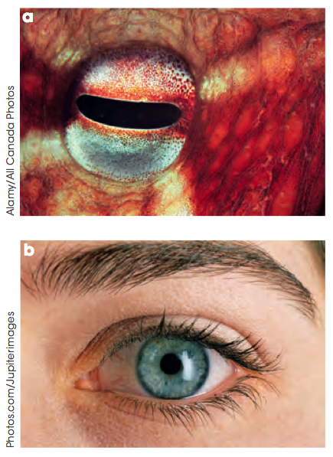
Analogous structures
Evidence for evolution
Analogous structures are features that serve the same purpose but do not have the same structure. These may arise by convergent evolution.
Figure 6.19

Slide 30
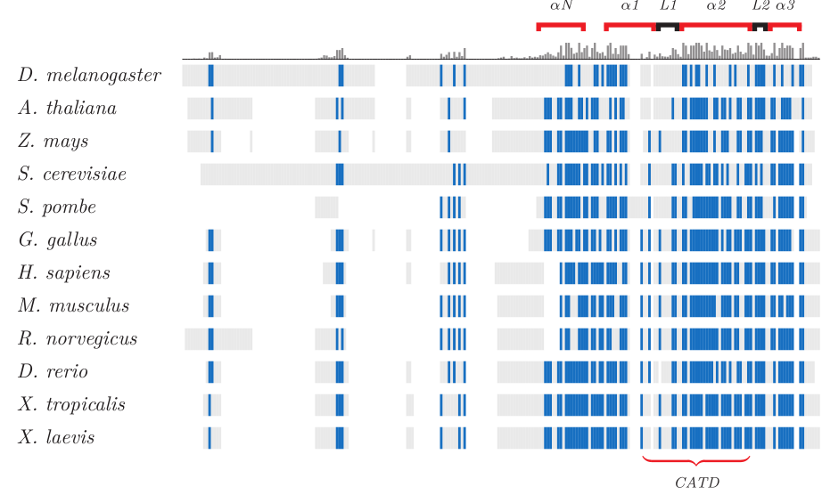
Molecular homology
Evidence for evolution
All living organisms share the same genetic code, which suggests that it is a very successful way of transmitting hereditary information and is highly conserved.
Proteins are often conserved if their structure is well suited to their function, even while species evolve.
An example is histone proteins, whose function is the same across different species.
In this figure, the sequence of a histone protein is compared across different species and conserved amino acids marked in blue.
http://www.incenp.org/research/cenpa.html

Slide 31
Molecular homology
Evidence for evolution
Mutations arise in DNA at a fairly constant rate, the mutation rate, which varies across species.
The mutation rate for humans is approximately 10⁻⁸ per nucleotide per generation.
Comparing the number of mutations in a DNA sequence can give an estimation of the time since two species diverged.

Slide 32
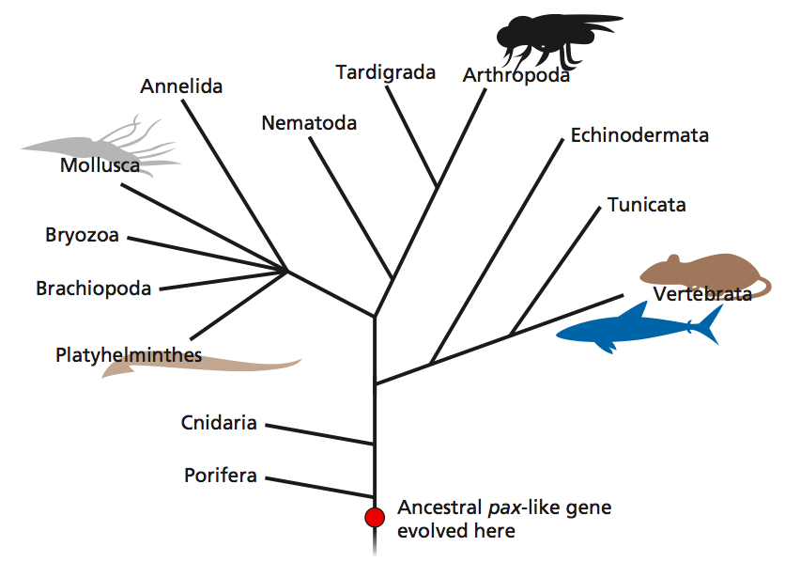
Molecular homology
Evidence for evolution
Comparative genomics uses bioinformatics to analyse genome sequences of different species for sequence conservation and mutation frequencies.
This can help to trace the evolutionary history of the divergence of the two genomes. This is can help to build a branching phylogenetic tree in the technique of molecular phylogeny.
The eye-building Pax gene has been conserved during evolution and can be used to create a molecular phylogeny.
Figure 6.21

